Slide 1
· ASSESSMENT 1
Assessment 1: Data Handling and Visualisation (7PAM2004)
TECHNICAL FOUNDATION
PROBLEM 1 · DAILY
PROBLEM 2 · HOURLY
Exploratory Visual Storytelling, Perceptual Critique & Multi-Dimensional Synthesis of the Capital Bikeshare Network
Candidate Truong Tan Phat · Student ID 9027KVDX
Module Leader Dr. Michael Kuhn · Tutor Andy Tai Hock Lin
PSB Academy & University of Hertfordshire · MSc Data Science 2026/2027
Notes:
0:00–0:30 — Good day, Andy. My name is Truong Tan Phat, and today I will present my analytical solution for Assessment 1 in Data Handling and Visualisation. To provide a clear analytical structure across both datasets, each problem section opens with a statistical pre-summary slide and concludes with a post-problem synthesis slide that translates visual findings into fleet operations.

Slide 2
Modular code architecture makes quality visible
Reusable plotting functions · ≥14 pt · 150 DPI · action titles · colorblind-safe double encoding
FUNCTIONS RETURN (fig, ax)
Physical-scale restoration: temperature ×41.0°C (mean 20.3°C) · humidity ×100% (mean 62.9%) · wind ×67.0 km/h (mean 12.8 km/h)
01 COMPLETENESS
02 VALIDITY
0 explicit nulls. One implicit MCAR humidity dropout on 2011-03-10 (Record 69, hum = 0.0%) imputed to 63.0% via 7-day rolling median.
Normalized features within [0,1]. Counts non-negative.
03 CONSISTENCY
04 UNIQUENESS
casual + registered = cnt (0 mismatches). No calendar gaps.
No duplicates. Unique instant key.
Notes:
0:30–1:10 — Before generating any visuals, I structured the notebook into modular functions enforcing 14-point minimum typography and double-encoded colorblind accessibility. I also converted normalized weather variables back into physical Celsius, percentage, and kilometer-per-hour units. Under our four-pillar data quality audit, although explicit null checks returned zero missing values, boundary inspection revealed a hidden sensor dropout on March 10, 2011, where humidity was logged as zero percent during rain. I imputed this to 63.0 percent using a 7-day rolling median.

Slide 3
Daily demand baseline: commuters dominate, weather defines the ceiling
Problem 1 pre-summary · day.csv · 731 daily observations
METRIC / REGIME
N
MEAN
MEDIAN
MIN–MAX
SD / PATTERN
Total cnt
731
4,504.3
4,548.0
22–8,714
1,937.2 (+64.9% YoY surge)
Registered
731
3,656.2
3,662.0
20–6,946
1,560.3 (81.2% majority cohort)
Casual
731
848.2
713.0
2–3,410
686.6 (Warm-weather lift >20°C)
Clear/Few Clouds
463
4,876.8
4,844.0
431–8,714
1,879.5 (Broad symmetric range)
Mist/Cloudy
247
4,035.9
4,043.0
605–8,362
1,809.1 (Resilient median)
Light Snow/Rain
21
1,803.3
1,817.0
22–4,639
1,240.3 (-63.0% hard ceiling)
ROADMAP → Fig 1 weather regimes · Fig 2 cohort elasticity · Fig 3 adoption trajectory
Notes:
1:10–1:45 — This pre-summary slide establishes the statistical baseline for Problem 1 across all 731 days. Total daily volume averages 4,504.3 rides with a median of 4,548.0 and a standard deviation of 1,937.2. Registered commuters account for over 81 percent of daily volume at a mean of 3,656.2 rides, whereas casual riders average 848.2 rides with pronounced right skewness. Figures 1 through 3 will now unpack these distributions.

Slide 4
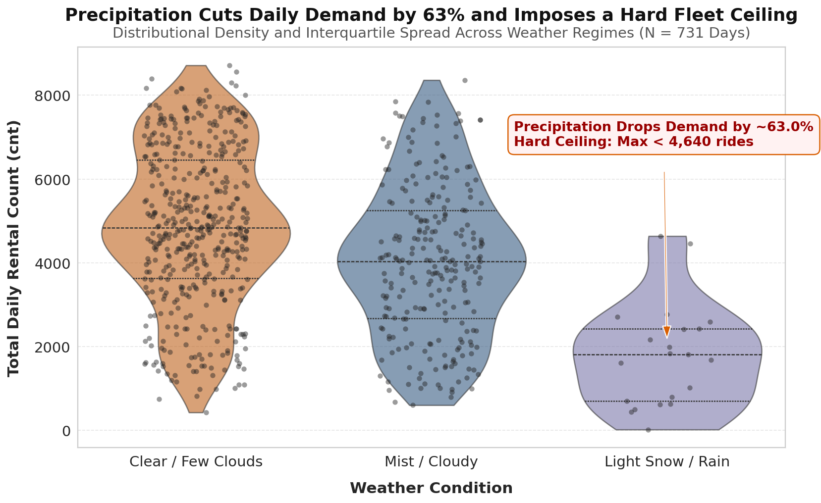
Rain and Snow Put a Hard Limit on Daily Bike Rides
DISTRIBUTIONAL EVIDENCE
Clear / Few Clouds
N 463 · mean 4,876.8
median 4,844.0
Mist / Cloudy ///
N 247 · mean 4,035.9
Light Snow / Rain xxx
N 21 · mean 1,803.3
median 1,817.0
The compressed upper neck shows precipitation imposing a hard ceiling—not merely shifting the average.
Notes:
1:45–2:20 — In Figure 1, pairing a kernel density violin plot with jittered observations and hatching textures exposes the full distributional impact of weather. Under clear skies, ridership is symmetrically distributed around a median of 4,844.0 rides per day. During light snow or rain, however, mean daily volume contracts by 63.0 percent to 1,803.3 rides, with a median of 1,817.0. The compressed upper neck confirms that precipitation imposes a strict operational ceiling.

Slide 5
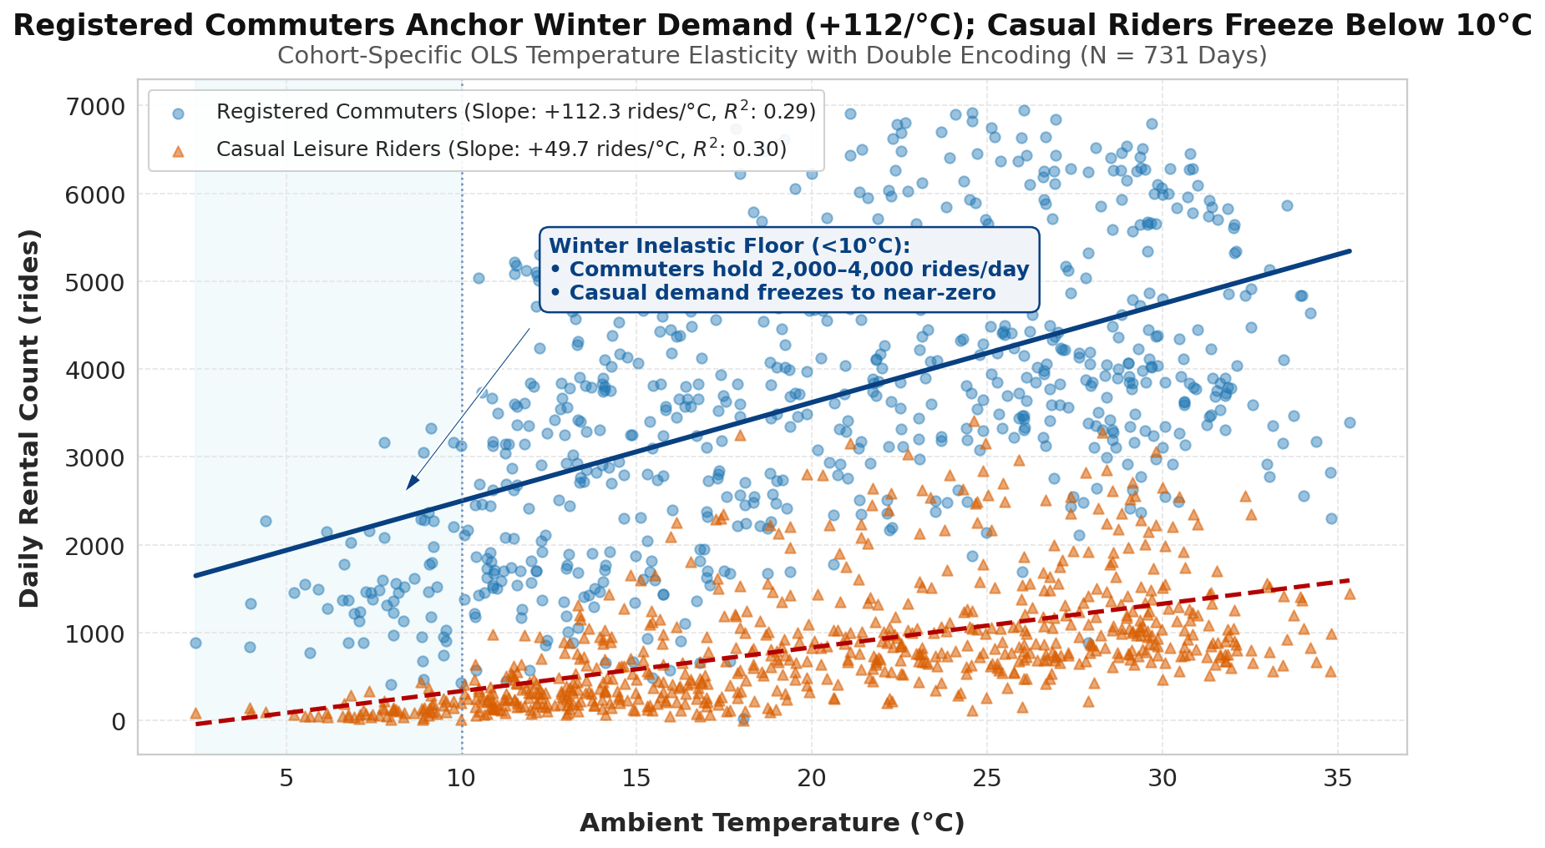
Commuters Keep Riding in the Cold, While Casual Users Disappear
REGISTERED ● SOLID
Intercept 1,376.0
Slope +112.3 rides/°C
R² 0.29 · p<0.001
Stable 2,000–4,000/day below 10°C
CASUAL ▲ DASHED
Intercept −161.3
Slope +49.7 rides/°C
R² 0.30 · p<0.001
Near-zero below 10°C; surges above 20°C
Notes:
2:20–2:55 — Figure 2 explains behavioral elasticity by separating registered commuters from casual users across ambient Celsius temperatures. Registered riders—encoded with blue circles and a solid OLS line—start from a freezing intercept of 1,376.0 rides and grow by 112.3 rides per degree Celsius, sustaining 2,000 to 4,000 daily trips even below 10 degrees. Conversely, casual riders—encoded with orange triangles and a dashed line—exhibit a slope of 49.7 rides per degree and vanish below 10 degrees Celsius.

Slide 6
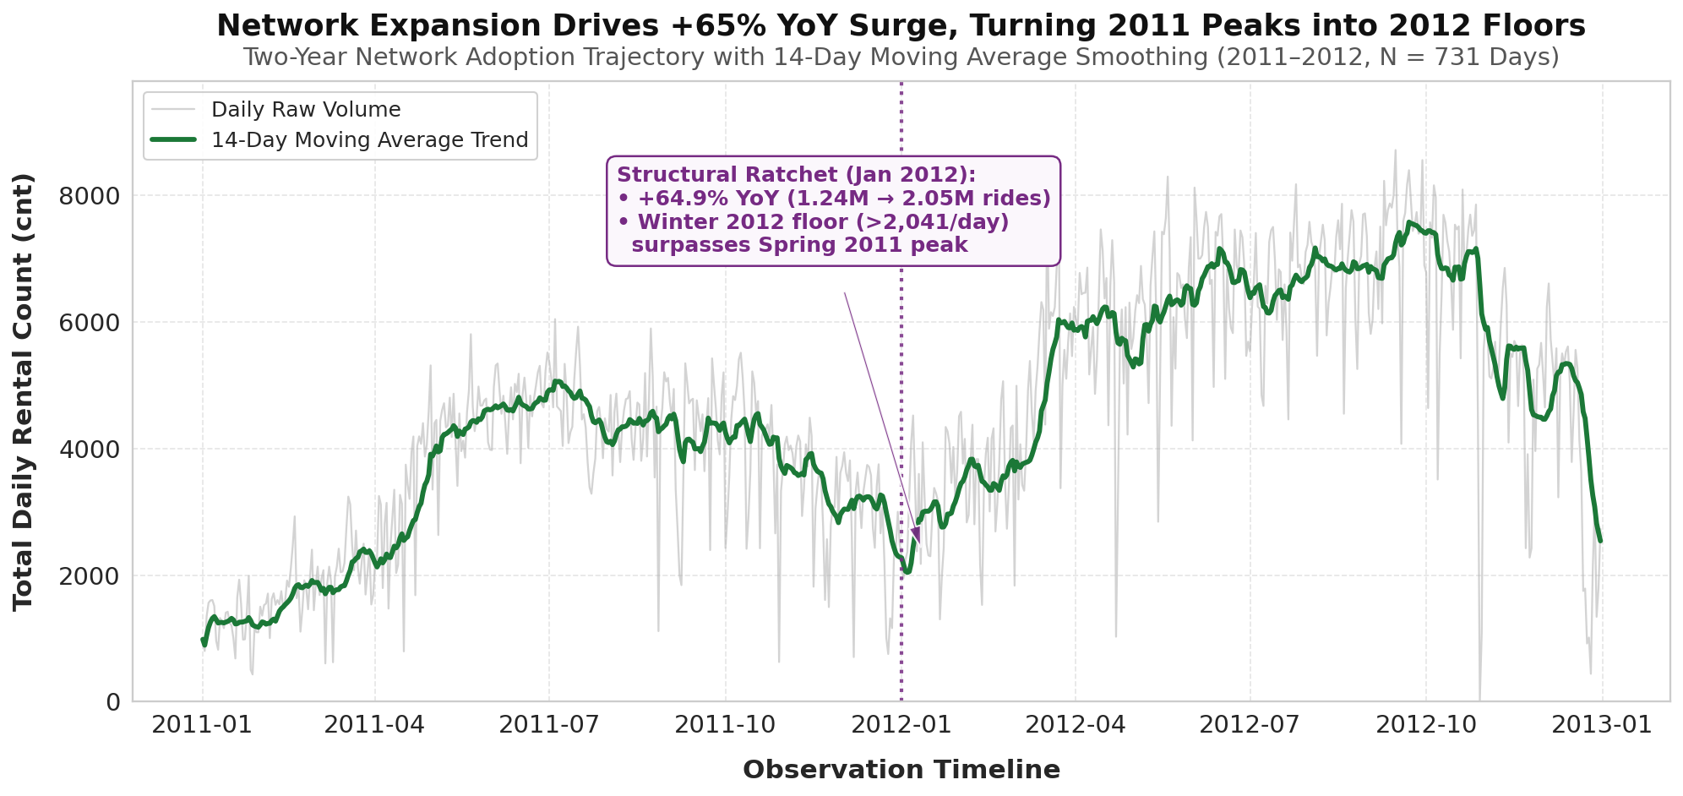
Rapid Growth Beat Winter Dips: 2012 Lows Beat 2011 Peaks
+64.9%
YEAR-OVER-YEAR
1,243,103 → 2,049,576 rides
Winter 2012 low stayed above 2,041.4 daily rides—evidence of a structural ratchet, not a seasonal rebound.
Notes:
2:55–3:25 — Figure 3 tracks the full two-year adoption trajectory using a 14-day moving average to smooth out daily weather fluctuations. At the January 1, 2012 milestone marker, we observe a clear structural ratchet effect: the winter low in early 2012 stayed above 2,041.4 daily rides, surpassing the early spring expansion peak of 2011. Total annual volume grew 64.9 percent year-over-year from 1.24 million to 2.05 million rides.

Slide 7
Three forces set the daily operating envelope.
01
02
03
ENVIRONMENTAL CEILING
COHORT DIVERGENCE
ADOPTION RATCHET
Precipitation cuts mean daily volume by 63%, creating a hard fleet-utilisation ceiling.
Registered commuters anchor winter demand. Exact slopes: +112.3 vs +49.7 rides/°C for registered vs casual.
Network expansion lifts the baseline: +64.9% annual growth from 1.24M to 2.05M rides.
Daily totals set capacity. Hourly patterns tell crews when to move bikes.
Notes:
3:25–3:50 — To wrap up Problem 1, our three macro charts establish three linked conclusions: precipitation imposes a 63 percent contraction ceiling, registered commuters anchor winter demand below 10 degrees Celsius, and network expansion drove a 64.9 percent annual surge. However, daily totals cannot tell logistics crews when to move bikes during the day, which brings us to Problem 2.

Slide 8
Hourly demand is right-skewed—and operationally defined by peaks
Problem 2 pre-summary · dataset_x.csv · 17,379 hourly records
SEGMENT
N
MEAN
MEDIAN
MIN–MAX
DISTRIBUTION
All hours
17,379
189.5
142.0
1–977
SD 181.4 · Right-skewed
Working day
11,865
193.2
151.0
1–977
SD 185.1 · Bimodal (08:00 & 17:00)
Non-working
5,514
181.4
119.0
1–783
SD 172.9 · Midday plateau (12:00–14:00)
Spring
4,242
111.1
76.0
1–801
SD 119.2 · Lowest baseline (floor 58.7/hr)
Summer
4,409
208.3
165.0
1–957
SD 188.4 · Wide IQR, surges >800/hr
Fall
4,496
236.0
199.0
1–977
SD 197.7 · Highest mean (clear 244.5/hr)
Winter
4,232
198.9
155.5
1–967
SD 183.0 · Clear (209.5) > Fall rain (172.0)
NEXT → critique A + Fig 4 · critique B + Fig 5 · weather–season matrix Fig 6
Notes:
3:50–4:25 — Opening Problem 2, this pre-summary table profiles all 17,379 hourly records in dataset_x.csv. Across the full dataset, hourly rentals average 189.5 with a median of 142.0, a standard deviation of 181.4, and extreme peak surges reaching 977.0 rides per hour. Supplied Charts A and B completely obscure these diurnal and distributional patterns, which we now resolve in Figures 4, 5, and 6.

Slide 9
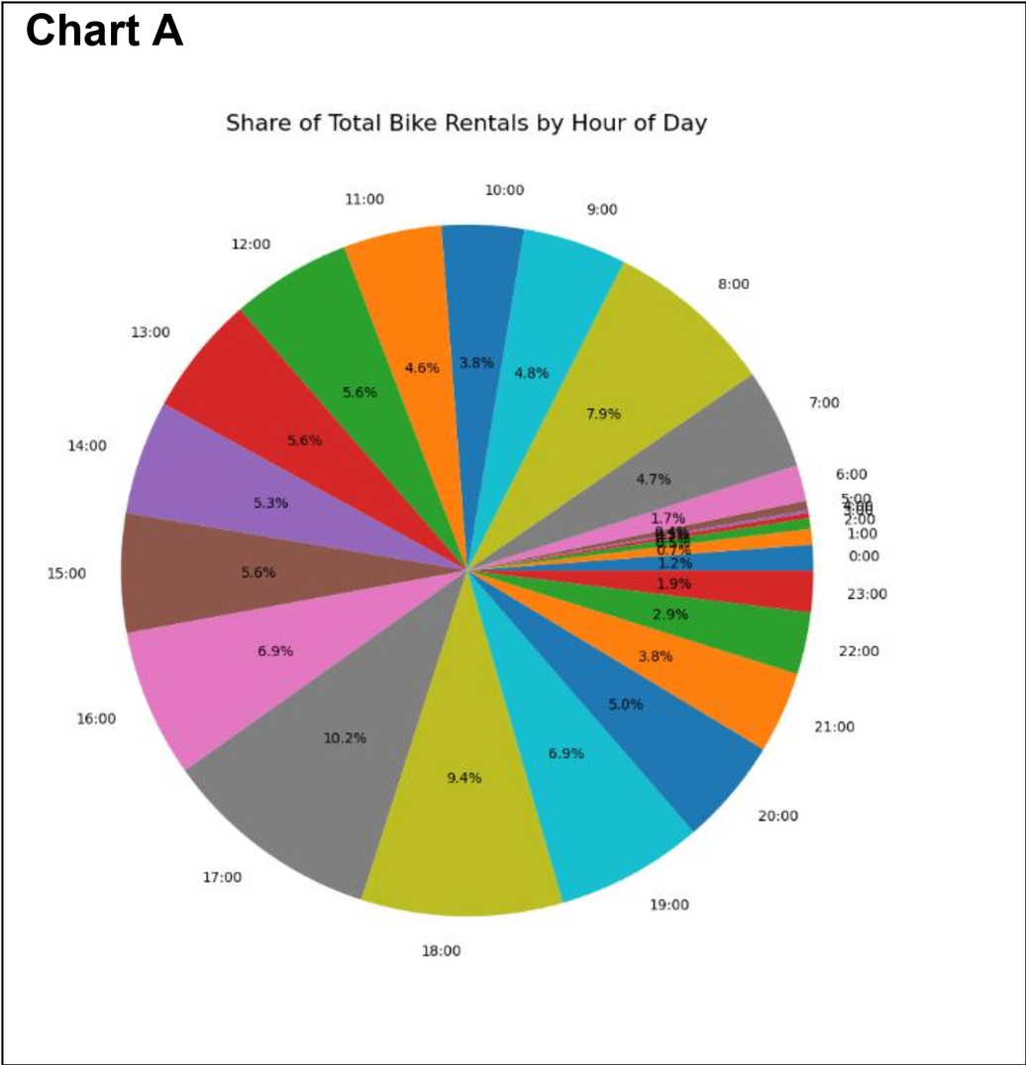
Why Supplied Chart A fails perceptually
Critique of Supplied Chart A · 24-slice pie chart of hourly bike demand (N = 17,379)
WHY THE 24-SLICE PIE FAILED
• Violates Stevens' Power Law: Human vision cannot accurately rank or compare 24 radial angles and slice areas.
• Severe label collisions: Night hours (00:00–05:00, <1% volume each) jam together into illegible overlapping text.
• Aggregation blindness: Pooling all 731 days hides weekday commute spikes vs. weekend leisure curves.
REDESIGN REQUIREMENT
Map all 24 hours onto a zero-anchored Cartesian scale decomposed by workingday (0 vs. 1) with double-encoded markers.
Notes:
4:25–5:05 — Supplied Chart A uses a 24-slice pie chart that violates Stevens' Power Law, causes severe label collisions between midnight and 5 AM, and pools all days together. In Figure 4, I replaced the pie chart with a Cartesian dual-line plot decomposed by day type. Working days immediately reveal sharp bimodal rush-hour peaks at 08:00 with 477.0 rides per hour and 17:00 with 525.3 rides per hour, whereas weekends form a smooth unimodal plateau between noon and 2 PM peaking at 372.7 rides per hour.

Slide 10
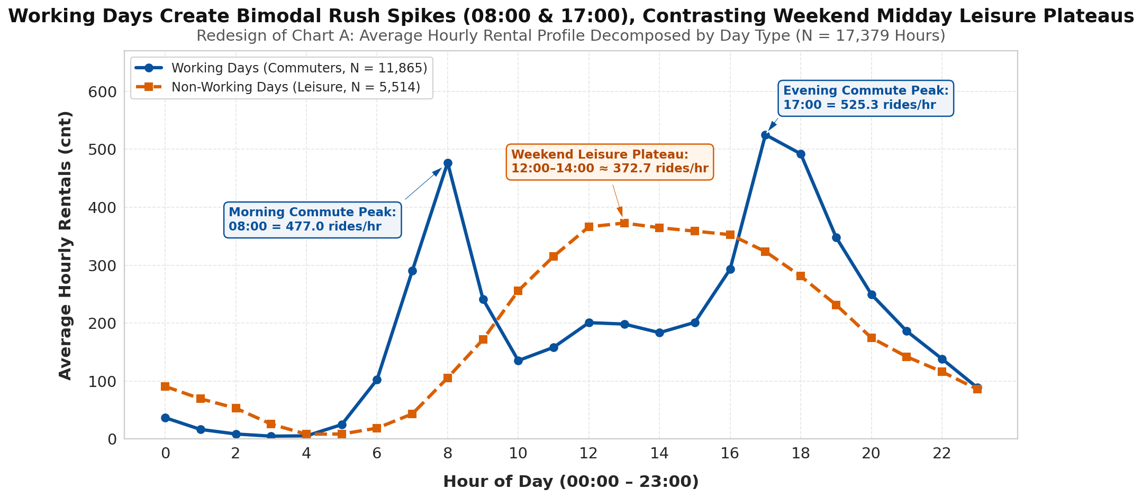
Move Bikes to Metro Stations on Weekdays, and to Parks on Weekends
DOUBLE-ENCODED REDESIGN
• Working Days (• Solid Blue, N = 11,865): Sharp bimodal rush-hour peaks separated by a midday trough (135.4–201.3/hr).
• Non-Working Days (■ Dashed Orange, N = 5,514): Smooth unimodal leisure curve across midday hours.
OPERATIONAL READOUT
08:00 = 477.0 rides/hr (Morning Peak)
17:00 = 525.3 rides/hr (Evening Peak)
Weekend 12:00–14:00 ≈ 372.7 rides/hr
Notes:
4:25–5:05 — Supplied Chart A uses a 24-slice pie chart that violates Stevens' Power Law, causes severe label collisions between midnight and 5 AM, and pools all days together. In Figure 4, I replaced the pie chart with a Cartesian dual-line plot decomposed by day type. Working days immediately reveal sharp bimodal rush-hour peaks at 08:00 with 477.0 rides per hour and 17:00 with 525.3 rides per hour, whereas weekends form a smooth unimodal plateau between noon and 2 PM peaking at 372.7 rides per hour.

Slide 11
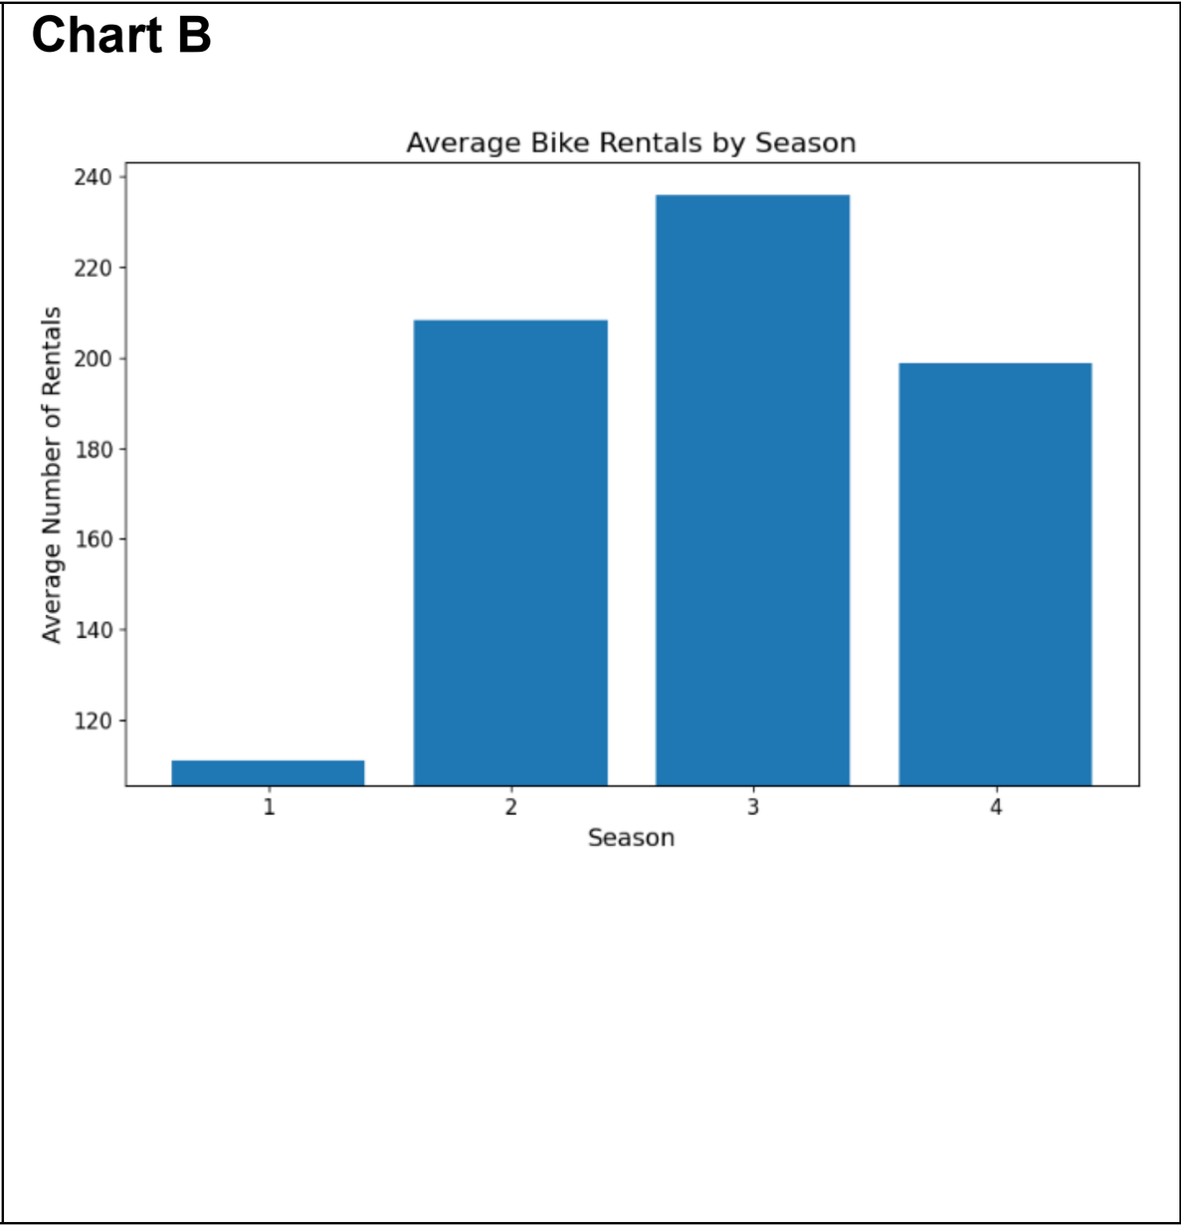
Why Supplied Chart B distorts seasonal ratios
Critique of Supplied Chart B · Truncated bar chart starting at y = 110 (N = 17,379)
WHY THE TRUNCATED BAR FAILED
• Severe Lie Factor (y-axis starts at 110): Season 1 (111.1/hr) looks nearly zero-height, making Season 3 (236.0/hr) look ~10x taller instead of the true 2.1x ratio.
• Conceals variance & outliers: Single-value bars hide IQR spread, skewness, and peak surges (>800–977/hr).
• Unmapped numeric codes: Raw 1–4 x-axis labels increase cognitive load.
REDESIGN REQUIREMENT
Restore a zero-anchored baseline (ylim = 0), map semantic season names, and expose full distributions + means.
Notes:
5:05–5:45 — Supplied Chart B truncates its vertical axis at 110 instead of zero, visually exaggerating Season 3 to look ten times larger than Season 1 when the true mean is 236.0 versus 111.1 rides per hour. Figure 5 restores a zero-anchored baseline using a seasonal boxplot with explicit black mean dots. In addition to showing honest seasonal averages, the boxplot exposes extreme peak-hour outliers above 800 to 977.0 rides per hour that govern docking station capacity.

Slide 12
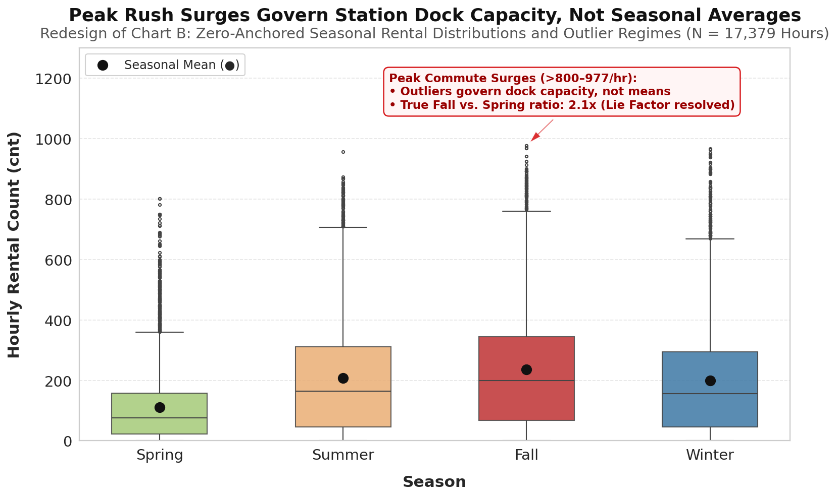
Build Stations for Rush-Hour Spikes, Not Average Traffic
DISTRIBUTIONAL EVIDENCE
• Fall (Season 3): Mean 236.0 · Median 199.0 · SD 197.7 (Highest demand)
• Summer (Season 2): Mean 208.3 · Median 165.0 · SD 188.4
• Winter (Season 4): Mean 198.9 · Median 155.5 · SD 183.0
• Spring (Season 1): Mean 111.1 · Median 76.0 · SD 119.2
CAPACITY TAKEAWAY
Upper-tail commute surges (>800 to 977.0 rides/hr) govern station dock capacity—not seasonal averages.
Notes:
5:05–5:45 — Supplied Chart B truncates its vertical axis at 110 instead of zero, visually exaggerating Season 3 to look ten times larger than Season 1 when the true mean is 236.0 versus 111.1 rides per hour. Figure 5 restores a zero-anchored baseline using a seasonal boxplot with explicit black mean dots. In addition to showing honest seasonal averages, the boxplot exposes extreme peak-hour outliers above 800 to 977.0 rides per hour that govern docking station capacity.

Slide 13
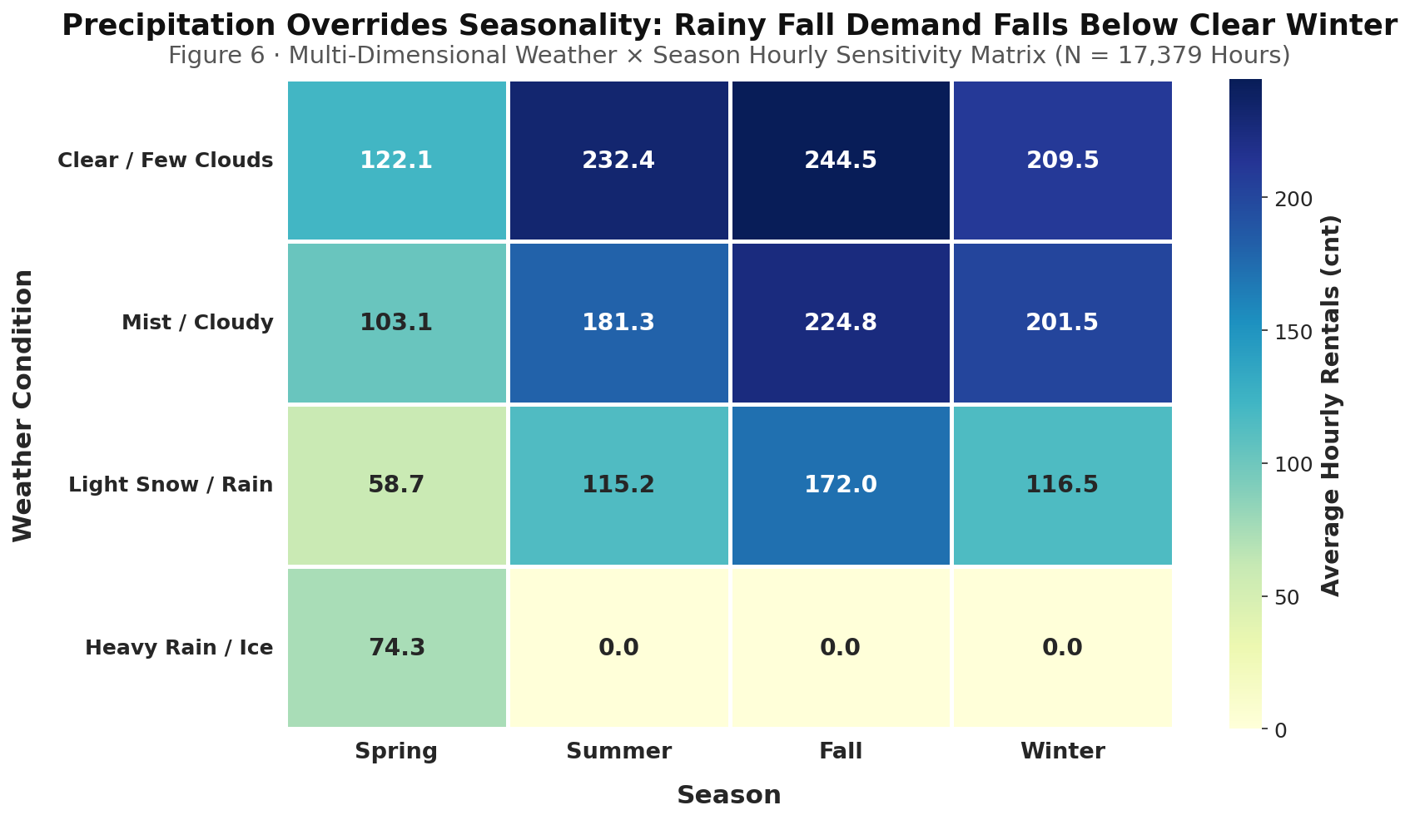
Rain Hurts Demand More Than Cold—Use Rainy Days for Repairs
Figure 6 · Multi-dimensional weather × season hourly sensitivity matrix
OPERATING READOUT
CLEAR SKY
Spring 122.1/hr
Summer 232.4/hr
Fall 244.5/hr
Winter 209.5/hr
RAIN / SNOW
Fall 172.0/hr
Spring 58.7/hr
HEAVY RAIN / ICE
Spring only · 74.3/hr
Fall rain underperforms clear Winter: 172.0 < 209.5 rides/hr.
Notes:
5:45–6:20 — While Figures 4 and 5 resolve diurnal and seasonal patterns separately, Figure 6 introduces a two-dimensional sensitivity matrix to examine how weather interacts with seasonality. Under clear skies, demand peaks in Fall at 244.5 rides per hour. However, rain or snow in peak Fall pulls ridership down to 172.0 rides per hour—lower than the 209.5 rides per hour achieved on a clear Winter day. Meanwhile, rainy Spring hours hit the network floor at 58.7 rides per hour.

Slide 14
Operate to peaks, not averages.
01
REBALANCE BY REGIME
08:00 (477.0/hr) and 17:00 (525.3/hr) weekday peaks; parks at 12:00–14:00 (372.7/hr) on weekends.
02
SURGE-BASED DOCK SIZING
Size Summer/Fall stations for peak surges (>800 to 977/hr);
sizing to the 189.5/hr annual mean guarantees dock overflows.
03
WEATHER-DRIVEN MAINTENANCE
Schedule fleet maintenance during rain/snow troughs (58.7–172.0/hr);
protects operational availability during peak sunny demand.
Thank you • Questions
Honest baselines · distributional transparency · double-encoded accessibility
Notes:
6:20–6:50 — In closing, this final synthesis slide connects Problem 2 and our overarching visual design principles—honest zero-anchored baselines, full distributional transparency, and double-encoded accessibility—into three concrete policies: dynamic weekday versus weekend van rebalancing, station dock sizing for 800-plus per hour peak surges, and opportunistic fleet maintenance during rainy low-demand windows. Thank you, Andy, and I welcome any questions.

